Slide 1
Workshop on the European Green Deal − Challenges and opportunities for EU fisheries and aquaculture Part III: Food security aspects
Rod Cappel, Poseidon Europe

Slide 2
Structure of the Presentation
1. Study objectives
2. Overview of main EGD Policy Instruments
3. Case Study 1: EU dependence on seafood imports
4. Case study 2: EU aquaculture production
5. Policy recommendations

Slide 3
1. Study objectives
Present an overview of the main European Green Deal (EGD) policy initiatives as regards food security.
Analyse the overall challenges, opportunities and solutions for EU fisheries and aquaculture with regards to food security and the transition to sustainability.
Illustrate best-practices and lessons learnt from case studies: (i) EU seafood imports and (ii) EU aquaculture.
Provide policy recommendations to the European Parliament.

Slide 4
2. Overview of main European Green Deal Policy Instruments (1)
The EGD is the EU’s overarching environmental strategy to address climate change and environmental degradation.
Climate change has severe consequences for fisheries: Redistribution of fish stocks and loss of catch potential.
Decreasing global catch also impacts aquaculture: 2/3 of production is currently dependent on food from wild fisheries. Increased disease risk & storm damage.

Slide 5
2. Overview of main European Green Deal Policy Instruments (2)
Farm to Fork, the EU’s food production strategy, has the most direct implications for food security.
Seafood species representing the bulk of production by weight are relatively low-carbon food.
Blue Farming promotes the expansion of shellfish and algae production in the EU.
‘Fit for 55’ package has implications for fuel intensive fisheries (32% of EU landings are from bottom trawl)
EU Biodiversity Strategy for 2030 may impact fisheries activity damaging seabed habitats and areas available for aquaculture growth.

Slide 6
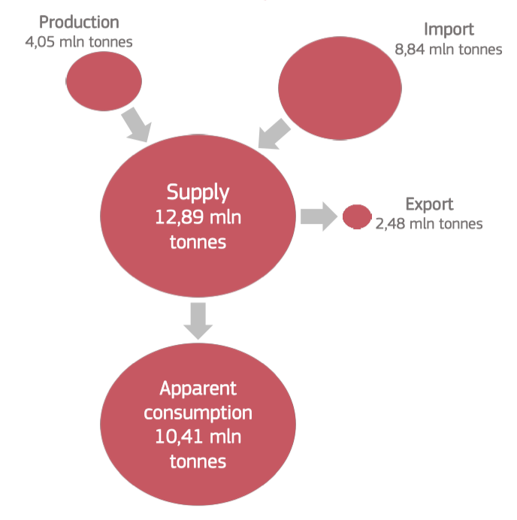
3. Case Study 1: EU dependence on seafood imports (1)
The EU produces 5 million tonnes of seafood a year (2% of global production, 7th largest globally). 4 million for direct EU consumption.
Growth in EU consumption supplied by extra-EU imports, often via intra-EU exchanges.
Asia is a major re-processing centre for EU seafood, but some decline since Covid19.

Slide 7
3. Case Study 1: EU dependence on seafood imports (2)
Recommended level of seafood supplies only met in 13 of 31 European countries with large coastlines / fish-eating cultures.
Encouraging healthier diets through fish consumption would mean a greater reliance on imports with current production.

Slide 8
3. Case Study 1: EU dependence on seafood imports (3)
Science-led management works: worldwide, assessed fish stocks have a greater relative abundance than unassessed stocks.
Sustainable fisheries models are well-understood but must be applied to all EU production and its imports.
The overcapacity in global fishing fleets is exacerbated by fleet subsidies.
The EU’s SFPAs with non-EU countries contribute around 9% of EU production. Instead of just avoiding negative food-security impacts, they can take positive action.

Slide 9
4. Case study 2: EU aquaculture production
EU aquaculture contributed around 1.1 million tonnes of seafood in 2020, half of which were low-trophic species.
The recent Strategic guidelines for sustainable EU aquaculture focus on building resilience, encouraging innovation and participating in the green transition.
EU aquaculture needs to diversify in terms of species and by production methods.
Greater focus on low and multi-trophic aquaculture, the use of circular materials, like insect meal in aquafeed and a holistic, ecosystem approach to aquaculture.

Slide 10
5. Policy recommendations (1)
Improve food security from EU fisheries:
Sustainable, science-based fisheries management.
Reduce emissions from the EU fishing fleet.
Address the environmental impacts of fisheries production.
Improve food security from EU aquaculture:
Formal adoption of the ecosystem approach to aquaculture (EAA).
Encourage low-trophic aquaculture & healthy consumption.
Recognise and use ecosystem services from aquaculture.
Innovative technology and approaches to reduce the environmental impact of aquaculture.
Encourage circularity in feed, equipment and techniques.

Slide 11
5. Policy recommendations (2)
Improve food security of imported seafood:
Support sustainable non-EU production (regional management, national support, knowledge-sharing).
Ensure a level playing field for EU producers (equal standards, clear labelling and improved traceability).
Improve food security in the seafood supply chain:
Improving the efficiency of supply chains.
Sustainable diets and consumption.

